Slide 1
SQL: Fasso Online Delivery Project
Basic to Advance

Slide 2
Tables Used
select* from customer1
select* from driver
select* from driver_order
select* from ingredients
select* from rolls_recipes
select* from rolls

Slide 3
Optimize and enhance the Fasoo online delivery system
Key Focus Areas for Analysis
Order statistics
Customer preferences
Driver performance
Delivery efficiency

Slide 4
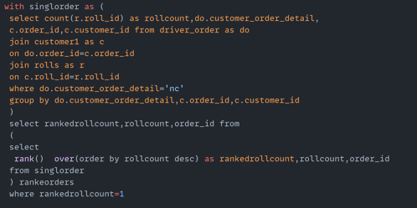
what is the maximum number of rolls delivered in a single order

Slide 5
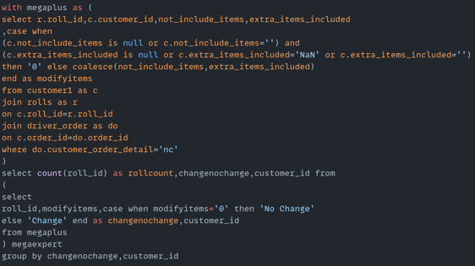
for each customer, how many delivered rolls had atleast 1 change and how many had no changes

Slide 6
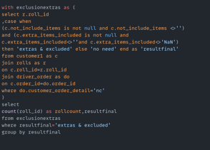
how many rolls were delivered that had both exclusion and extras

Slide 7
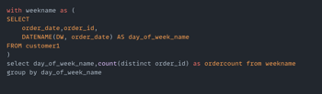
what was the total no of rolls ordered for each hour of the day

Slide 8
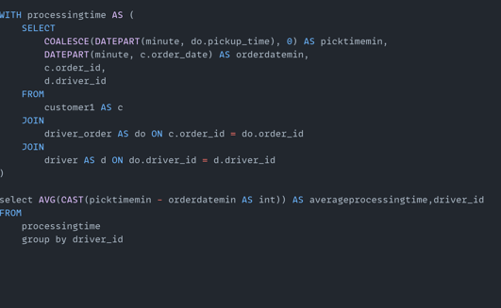
what was average time in minutes it took for each driver to arive at fasoos HQ to pickup the order

Slide 9
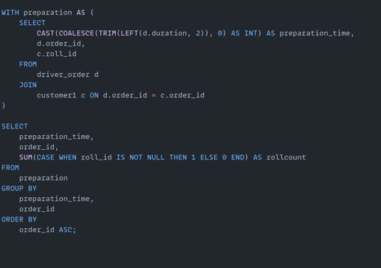
is there any relationship between no of rolls and and how long the order takes to prepare?

Slide 10
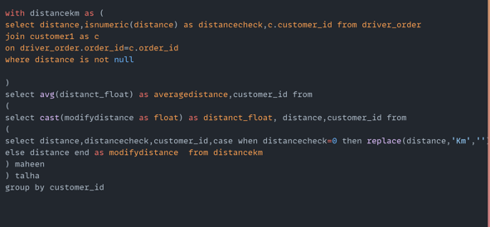
what is the average distance travelled for each customer

Slide 11
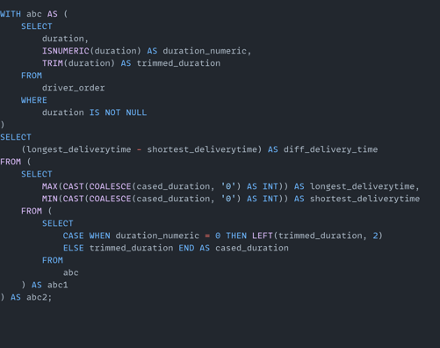
what was the difference between shortest and longest delivery times for all orders?

Slide 12
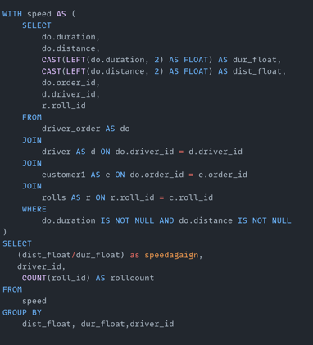
what was the average speed for each driver for each delivery and do you notice any trend for these values?

Slide 13
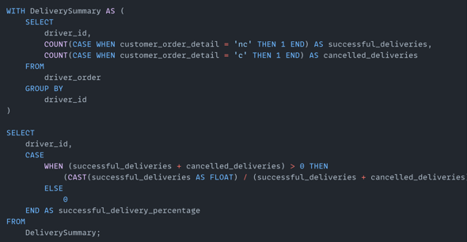
calculate the successfull delivery %age for each driver

